Slide 1
Welcome to KS4 Options Information Evening
Tuesday 2nd March 2021
Mrs Cull (ruth.cull@darwenvale.com)
Vice Principal

Slide 2
Welcome to KS4 Options Evening 2021
A reminder of changes in Key Stage 4 education
The rationale behind the DVHS Key Stage 4 curriculum offer
A guide to the options process

Slide 3
A reminder of changes in Key Stage 4 education
Content: New and more challenging content
Structure: Exams at the end of the course
Assessment: Mainly by examination. Non-exam assessment only where necessary
Tiers: Foundation and higher tier permitted only in maths, science and modern foreign languages
Grading: New numbered scale (9 to 1 plus U), 9 is the highest Government ‘good pass’ set at grade 5, ‘standard pass’ set at grade 4.

Slide 4
Old system of A*− G has 8 possible grades
New system of 1 − 9 has 9 possible grades

Slide 5
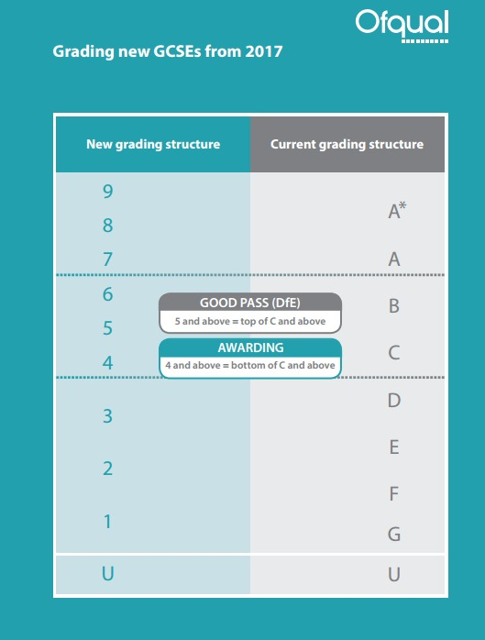
Grade 5 is positioned in the top third of the marks for a current grade C and bottom third of the marks for a current grade B.
This will mean it is of
greater demand than the
old grade C.

Slide 6
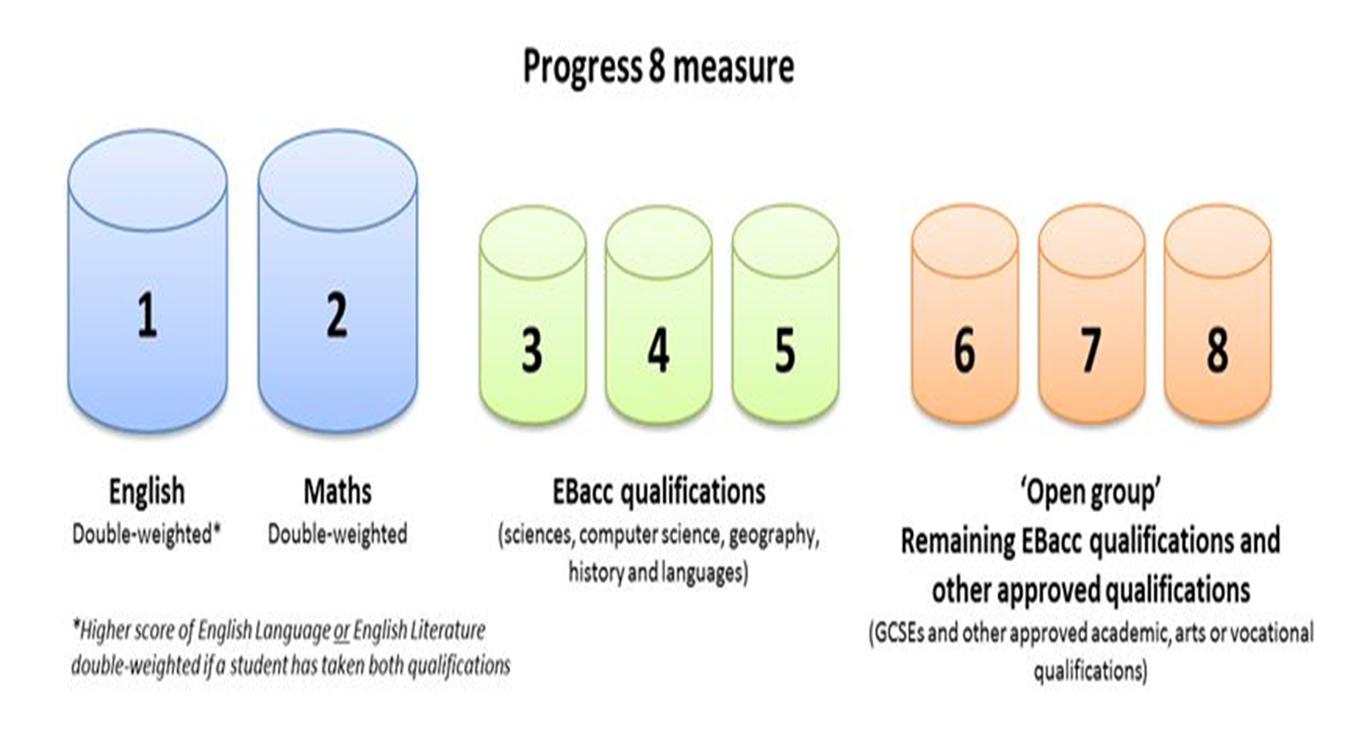
GCSE Performance Measures
Progress 8: Pupils results across 8 subjects are compared to the progress of other pupils nationally with a similar prior attainment
Attainment 8: is a measure of a pupil’s average grade across a set suite of 8 subjects

Slide 7
GCSE Performance Measures
% of students achieving “Good Pass” (Grade 5 or above) in English and Maths
% of students achieving “Standard Pass” (Grade 4 or above) in English and Maths
Pupil destinations: % of pupils staying in education or going into employment after KS4

Slide 8
The English Baccalaureate measure
It’s a combination of GCSE subjects that offer important range of knowledge and skills to young people

Slide 9
Choosing the ebacc route
You will ALL study English, Maths and Science
To follow an ebacc route you need to choose:
Geography OR History
French
1 other option (from any of the options)
E.g.
Pupil A: History, French and Sport
Pupil B: Geography, French and Computing
Pupil C: History, Geography and French

Slide 10
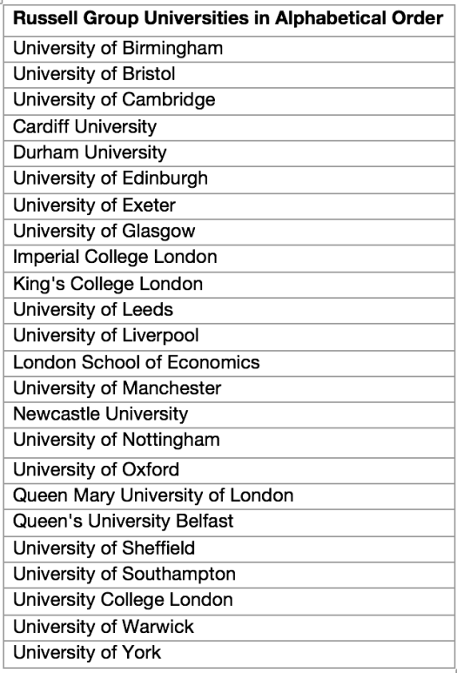
The ebacc is HIGHLY REGARDED by Russell Group Universities
The Russell Group is an association of twenty-four universities in the United Kingdom. The association represents the very best in public universities dedicated to research, pedagogy and quality education.

Slide 11
Key Stage 4 curriculum offer
2-year Key Stage 4
All students will study:
English Language
English Literature
Mathematics
Combined or Triple Award Science
Core PE*
Everyone will choose 3 options
3
Notes:
Option subjects have this year been given more time with it being a 2 year key stage 3.

Slide 12
DVHS KS4 Curriculum Offer
Subject | Number of lessons
English | 5
Maths | 5
Science | 5
Option 1 | 3
Option 2 | 3
Option 3 | 3
Core PE | 1
 | =25

Slide 13
Reserve option
Everyone MUST choose a reserve option
It may be that your other 3 options all cannot be accommodated
There might also be the possibility of the 4th option running as a period 6 session
If you feel more than able to do 4 rather than 3 options please speak to Mrs Cull as soon as possible (still pick a reserve).

Slide 14
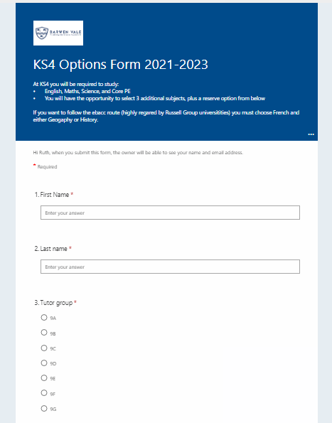
Options form is online this year
A link to access it will be sent to your SCHOOL EMAIL ADDRESS tonight
Take your time to complete it as once you press submit you cannot go back and re-do it.
Deadline to complete it is Monday 15th March
Notes:
BLUE subjects make up the English Baccalaureate suite of qualifications
Triple Science and Computer Science will limit your final choice if you want to follow an Ebacc route

Slide 15
Timeline of the options process
Options Form Deadline: Friday 12th March
Options Interviews w/b : Monday 15th March
Options Confirmed: End of June

Slide 16
Which options?
Ability and success
Favourite teacher
Interest
My friend picked it
Aspiration
Don’t pick it because its easy

Slide 17
Questions to ask?
Content – what will you learn?
Delivery – how much is coursework? Exam?
Career opportunities – what type of careers/courses etc does this qualification lead to?
Success – what % of pupils achieved a grade 4+, 5+ etc last two years? What is the progress 8 score?
Interests – what do you like about teaching it?

Slide 18
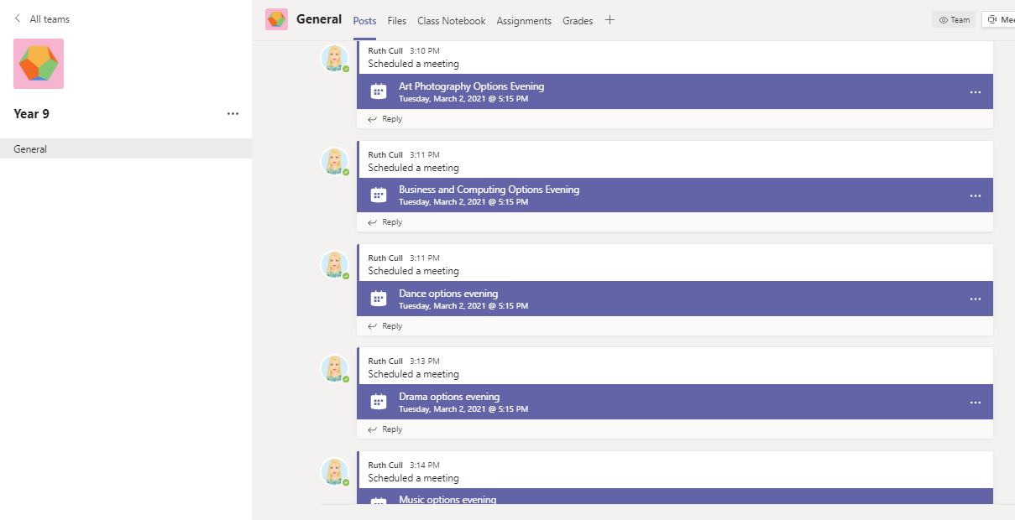
The best people to ask about the option choices is your teachers…….
Go to the Year 9 Team in MS Teams and join the relevant subject session.

Slide 19
Teachers from every option subject are available now via Teams till 7pm.
Option subject | Teachers
Art & Design | Mrs Kay Ramsay
Art Photography | Mr Scott Knowles
Astronomy/Triple Science | Mrs Steph Penney
Business/Computing/ICT | Miss Jill Mitchell/Mrs Ruth Cull
Dance | Miss Andrea Christou-Savva
Drama | Mr Curtis Bebro
French | Miss Melissa Jones/Miss Alexia Devienne/Miss Caroline De Bel-Air
Geography | Mr John Pearson/ Mrs Stephanie Miller/ Mrs Laura Robinson
History | Mrs Gregson/Mrs Bleasdale
Hospitality & Catering | Mr Neil Barnett
Music | Miss Emma Jones
Sport | Mr Simon Pilkington

Slide 20
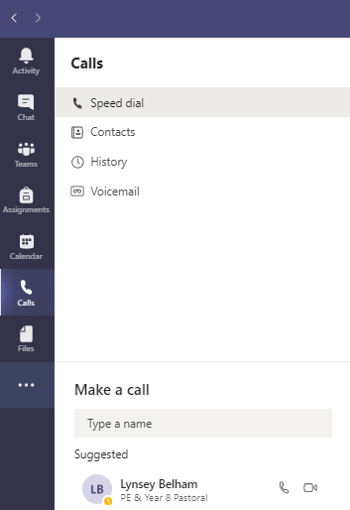
Or call Mrs Cull, Mrs Belham or Mrs McKenna if you have any specific questions
On MS Teams go to Calls – Make a Call.
Start to type in the teachers name and press Call

Slide 21
More information
Pastoral Staff – Mrs Belham (LBelham@darwenvale.com) and Mrs McKenna (Claire.Mckenna@darwenvale.com)
Senior Leadership – Mrs Cull (ruth.cull@darwenvale.com)
Additional Needs – Mrs Pollitt (SPollitt@darwenvale.com)

